Slide 1
Lecture Title: Recursion
Course Code: CSC 2211
Course Title: Algorithms
Dept. of Computer Science
Faculty of Science and Technology
Lecture No: | 5 | Week No: | 06 | Semester: | Summer 22-23
Lecturer: | Pritam Khan Boni; pritam.khan@aiub.edu

Slide 2
The divide- and- conquer design paradigm
Example: merge sort
1. Divide: Trivial (array is halved).
2. Conquer: Recursively sort 2 subarrays.
3. Combine: Linear- time merge.
Recurrence for merge sort
Let T( n ) = Time required for size n
T( n ) =
Sub-problem
Size (n/2)
2
*
T( n / 2)
+
O( n)
Number Of Subproblems
Time required for each Subproblem
Work Dividing and Combining
*
+

Slide 3
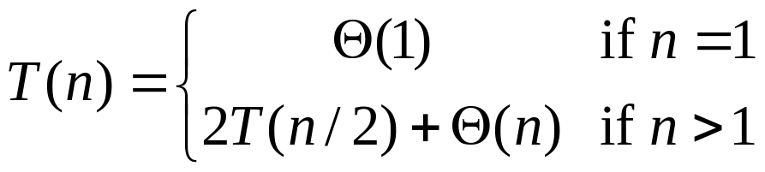
Recurrences
Running times of algorithms with recursive calls can be described using recurrences.
A recurrence is an equation or inequality that describes a function in terms of its value on smaller inputs.
For divide and conquer algorithms:
Example: Merge Sort

Slide 4
Solving Recurrences
Repeated (backward) substitution method
  Expanding the recurrence by substitution and noticing a pattern (this is not a strictly formal proof).
Recursion-trees
Master method
  templates for different classes of recurrences

Slide 5
Repeated Substitution Method
The procedure is straightforward:
Substitute, Expand, Substitute, Expand, …
Observe a pattern and determine the expression after the k-th substitution.
Find out what the highest value of k (number of iterations, e.g., lg n) should be to get to the base case of the recurrence (e.g., T(1)).
Insert the value of T(1) and the expression of k into your expression.

Slide 6
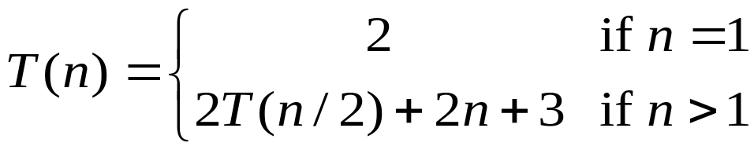

Repeated Substitution Method
assume 2^{k-1}< n ≤ 2^{k}.
So upper bound for k is
n = 2^{k}
K = log₂n = lg n
T(n) = 2T(n/2) + 2n + 3 substitute
= 2(2T(n/4) + n + 3) + 2n +3 expand
= 2²T(n/4) + 4n + 2x3 + 3 substitute
= 2²(2T(n/8) + n/2 + 3) + 4n + 2x3 + 3 expand
= 2³T(n/2³) + 2x3n + 3x(2²⁺2¹⁺2⁰) observe pattern
T(n) = 2^{k}T(n/2^{k}) + 2kn + 3
= 2^{k}T(n/2^{k}) + 2nk + 3 (2^{k}-1)
= nT(n/n) + 2n lg n + 3(n - 1)
= 2n+2n lg n + 3n - 3
= 5n + 2n lg n – 3
T(n) = O(nlgn)

Slide 7

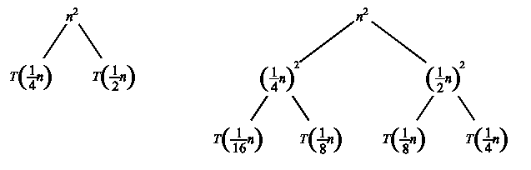
Recursion Tree Method
A recursion tree is a convenient way to visualize what happens when a recurrence is iterated.
  Good for ”guessing” asymtotic solutions to recurrences

Slide 8
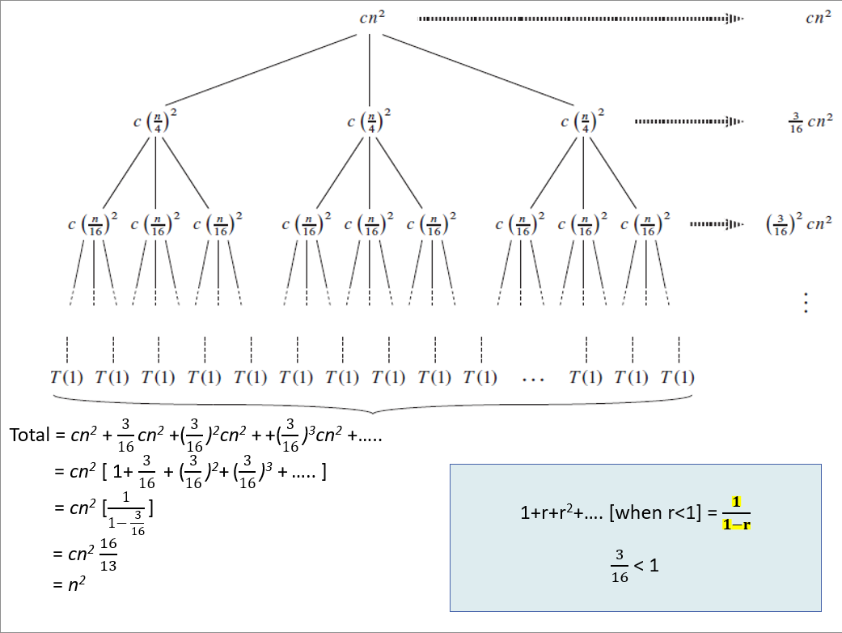
Recursion Tree Example

Slide 9
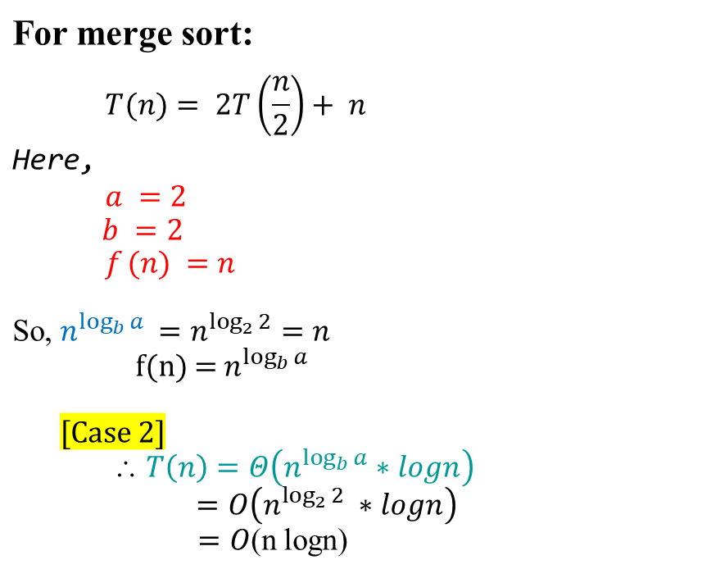
Master Theorem Example
T(n) = a T(n/b) + f (n) ,
where
a ≥ 1,
b > 1, and f is asymptotically positive.
Compare
f(n) and n^{logba}

Slide 10
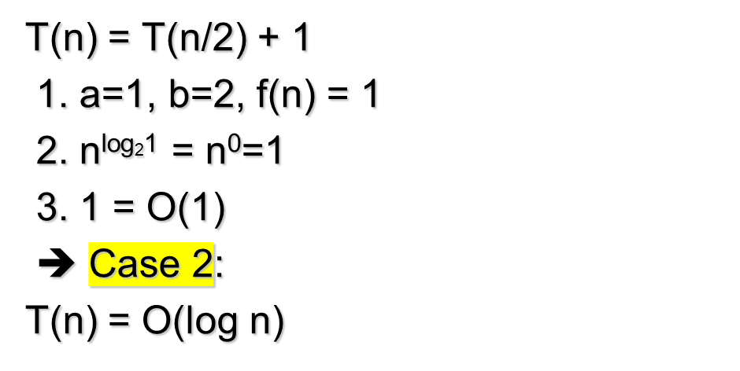
Master Theorem Example
BinarySearch(A, l, r, q):
m := (l+r)/2
if A[m]=q then return m
else if A[m]>q then
BinarySearch(A, l, m-1, q)
else BinarySearch(A, m+1, r, q)

Slide 11
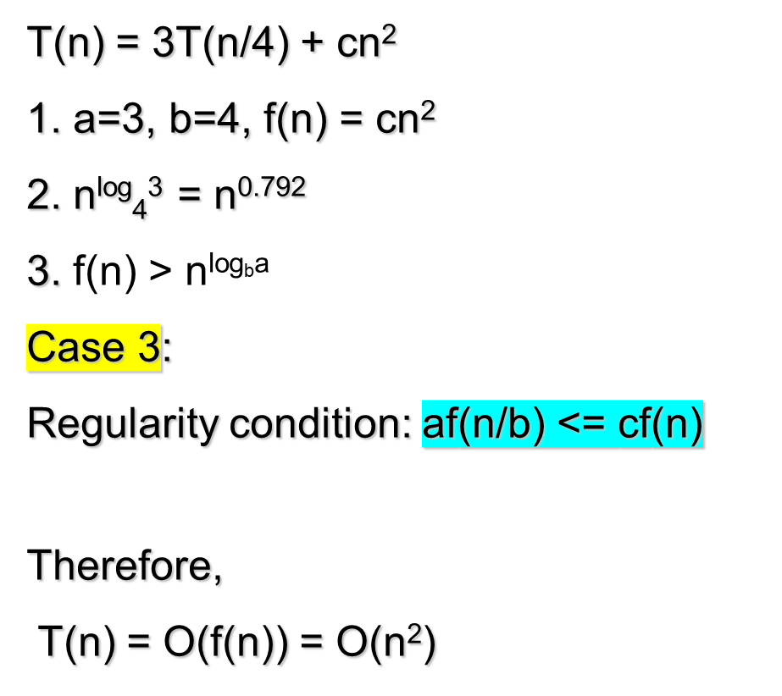
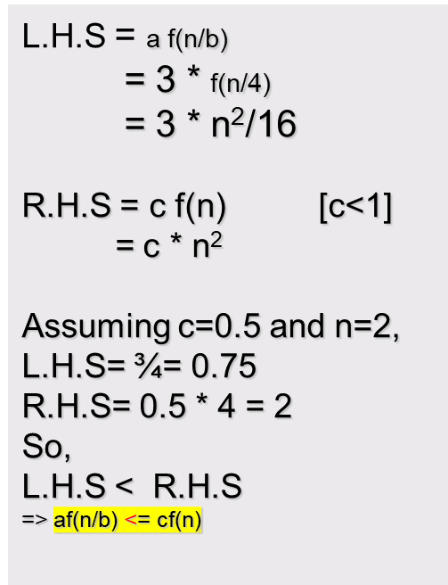
Master Theorem Example
f(n)= n²
f(n/4)= (n/4)²
=n²/16

